Slide 1
Super Forecasting Project
SCH-MGMT 650 STATISTICS FOR BUSINESS - PROF BRETT ALBERT
Stats Family #2
Geetha Ragiphani
Anand Gupta
Sumanth Nomula
Sahibnoor Chahal
Super Forecasting Project | Fall 2023

Slide 2
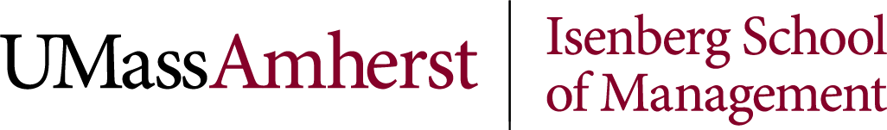
Q1: How far will England advance in the 2024 European Football Championship?
Establishing Bayesian Prior Probability: The outside view
England National Football team's current FIFA Ranking is 3rd & in UEFA it is 2nd.
Final standing of UEFA 2nd ranked country in European Football Championships since the inception of FIFA
FIFA Rank | UEFA Rank | Country | UEFA Euro Year | Final Standing
2 | 2 | Italy | 1992 | DNQ
3 | 2 | France | 1996 | SF
4 | 2 | Italy | 2000 | 2nd
4 | 2 | Czech Republic | 2004 | SF
2 | 2 | Germany | 2008 | 2nd
2 | 2 | Germany | 2012 | SF
5 | 2 | Belgium | 2016 | QF
2 | 2 | France | 2020 | R16
Probability of a 2nd ranked team’s standing in Euros, based on last 8 editions is as under
R16 – 87.5%
QF - 75.00%
SF - 62.50%
F - 25.00%
[4]
[5]
[6]
Super Forecasting Project | Fall 2023

Slide 3
Q1: How far will England advance in the 2024 European Football Championship?
Updating Beliefs: The Inside View
Present performance of England squad :
- England reached the finals of EURO 2020 with the same manager, Gareth Southgate and captain, Harry Kane.
- England won all their matches in EURO 2024 qualifiers and in 2023, they have won 80% of the matches played and drew 20% losing nil.
- England reached its best ranking in 2023 and the team is in great form.
Current Players :
- No key injuries have been reported so far and the squad is at full strength. Based on the above, we can assume P(Recent Performance) at 85% as they not lost a match in this year so far.
Performance in Penalty shootouts:
- England has performed poorly when it comes to Penalty shoot outs, as they won only 3 matches out of 10 in high profile tournaments., we are assigning probability of England winning in Penalty shoot outs at 30%.
-Since only two matches so far have been drawn this year out of 10, the probability of a R16, QF match going to penalty shootout is 20%.
Probability of win is 0.8*0.85 +0.2*0.3 = 0.74.
In, finals, the probability of a match going to penalty shootout increases, hence we are increasing the probability to 40% and 50% respectively
So, the probability of win is 0.6*0.85 +0.4*0.3 = 0.63 (Semifinal) and 0.5*0.85+0.5*0.3 = 0.575
Black Swan event:
- Key player, captain Harry Kane who has not been injured since the last 3 years getting injured and exiting the tournament – P (Black Swan) – 5%
New evidence Probability = 80.75% (85%*95%) – Round of 16
New evidence Probability = 70.30% (74%*95%) – QF,
New evidence Probability = 59.85% (63%*95%) – SF
New evidence Probability = 54.15% (57%*95%) – F
[8]
[7]
Super Forecasting Project | Fall 2023

Slide 4
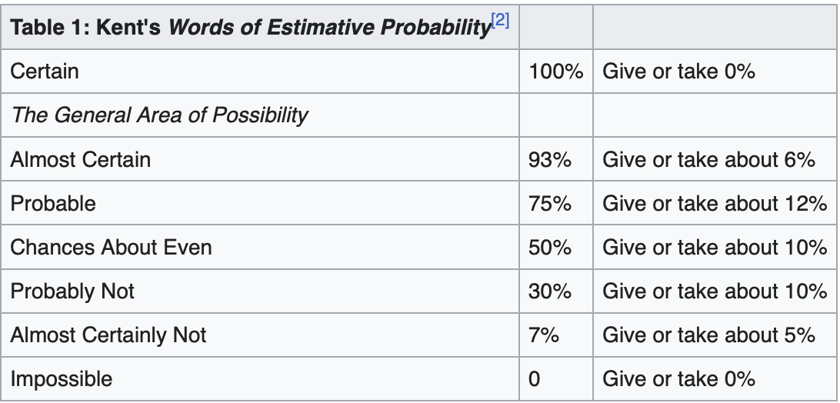
Q1: How far will England advance in the 2024 European Football Championship?
Conclusion:
Upon calculating posterior probability for
each instance based on Bayesian Prior and Present situation
For (R16, QF, SF &F):
Based on Kent’s chart of probability, it is Probable England will be reaching Quarter Finals, as the calculated posterior probability is 73% and they have Chances about even to reach Semi Finals.
Variables | R16 | QF | SF | F
Prior -x | 0.875 | 0.75 | 0.625 | 0.25
New Belief -y | 0.81 | 0.7 | 0.6 | 0.54
(x+y)/2 | 84% | 73% | 61% | 40%
Super Forecasting Project | Fall 2023

Slide 5
Q2: Will there be a lethal confrontation between the national military forces of Russia and the United States before December 31, 2024?
Establishing Bayesian Prior Probability: The outside view
How many lethal confrontations have occurred between countries possessing nuclear weapons in the past 100 years?
In the history of mankind, there has only been one instance where nuclear weapons were used by military forces during lethal confrontations. Based on this, our Bayesian prior will be 1/100 = 1%
Super Forecasting Project | Fall 2023

Slide 6
Q2: Will there be a lethal confrontation between the national military forces of Russia and the United States before December 31, 2024?
Updating Beliefs: The Inside View:
US’ support to Ukraine in the ongoing Ukraine-Russian war:
Historically, US has shown strong patterns of support for its allies in their domestic and international affairs. There have been far less instances of them not showing support due to peace treaties and other acts. [1]
P(US Support) = 0.85
The impact of Trade sanctions on Russia by US and its allies:
Russia has shown short-term resilience when sanctioned by US and its allies, but there have been long term consequences too, including shifts in economic policies, growing dependence on specific partners, and potential risks associated with isolation from global economic dynamics. [2]
P(Trade Sanctions Impact) = 0.4
[1] http://www.news.cn/english/2021-10/01/c_1310221820.htm
[2] https://carnegieendowment.org/politika/89708
Super Forecasting Project | Fall 2023

Slide 7
Q2: Will there be a lethal confrontation between the national military forces of Russia and the United States before December 31, 2024?
Updating Beliefs: The Inside View:
3. Role of International Organizations such as UN, NATO, OPEC+
There are a lot of sub-questions that come into play when we consider the role and impact of international organizations in such situations. How long has the dispute been? Do more member nations mean less conflict onsets? Is there a moral hazard problem?
Taking into consideration all these factors and based on our research [3], we’ve found that even though there have been no nuclear confrontations since organizations like the UN were formed, the probability of International Organizations playing the role of conflict resolution is substantially lower than expected.
P(IO Role) = 0.3
[3] https://www.jstor.org/stable/40931157?seq=16
Super Forecasting Project | Fall 2023

Slide 8
Q2: Will there be a lethal confrontation between the national military forces of Russia and the United States before December 31, 2024?
Conclusion:
Predicting a lethal confrontation between Russia and the U.S. by December 31, 2024, is complex. While historical U.S. support for allies and economic sanctions on Russia play roles, the effectiveness in preventing conflict is uncertain.
International organizations, despite their aim to resolve disputes, historically show lower-than-expected effectiveness. The outcome depends on evolving geopolitical dynamics, emphasizing the need for ongoing diplomatic efforts and international cooperation to mitigate the risk of armed hostilities.
The outcome depends on these multifaceted dynamics, underscoring the need for ongoing diplomatic efforts, international cooperation, and proactive measures to prevent armed hostilities.
Taking into consideration the cluster questions and the impact they have on the Bayesian Prior we set initially, we can safely say that these factors will only decrease the value of our Bayesian prior.
Super Forecasting Project | Fall 2023

Slide 9
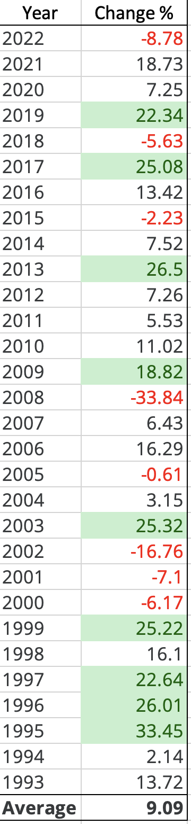
Q3: Will the Dow Jones Industrial Average finish 2024 higher than 43,000?
Establishing Bayesian Prior Probability: The Outside View
What is the Dow Jones Industrial Average now? 36,204.44 In order to finish the 2024 at a value higher than 43,000, it would need a year-over-year increase of about 18.77%.
The chart alongside shows year-over-year change in percent over the past 30 years. In 9 such instances, the increase was larger than the overall average. Based on this data, we can set our Bayesian Prior at 9/30 = 0.3
Super Forecasting Project | Fall 2023

Slide 10
Q3: Will the Dow Jones Industrial Average finish 2024 higher than 43,000?
Updating Beliefs: The Inside View
Historical relationship between GDP growth and the Dow Jones performance:
Over a long term, there is appositive correlation between GDP growth and DJIA performance.
Company specific factors: DJIA heavily and directly relies on corporate earnings, industry performances, and global market conditions.
Looking into all of this, we believe even though there does exist a relationship between DJIA and GDP, the correlation isn’t that strong. P(DJIA & GDP) = 0.5
2. DJIA vs S&P 500:
These 2 are widely followed stock market indices in the US. Even though the correlation between them is strong, it is important to note that correlation does not imply causation. Factors like the size of their indices, their composition, market dynamics and events, investor sentiments cause a difference in their performances. Upon comparing their historical data, P(DJIA vs S&P 500) = 0.6
Super Forecasting Project | Fall 2023

Slide 11
Q3: Will the Dow Jones Industrial Average finish 2024 higher than 43,000?
Updating Beliefs: The Inside View
Impact of global events:
The US National Elections or significant political changes in major economies can affect the market sentiment.
Geopolitical tensions like the ongoing Ukraine – Russia war can create uncertainty in financial markets. These could also include issues like trade disputes, territorial conflicts and diplomatic tensions.
Key economic indicators such ash GDP growth, employment figures and inflation rates can shape market sentiment. Positive or negative surprises in economic data can influence investor perceptions.
Considering these factors, the probability of global events occurring and causing a positive change in the DJIA value can be set at P(Global Events) = 0.75
Super Forecasting Project | Fall 2023

Slide 12
Q3: Will the Dow Jones Industrial Average finish 2024 higher than 43,000?
Conclusion:
Using Nate Silver’s formula, to calculate posterior probability:
x*y/(x*y + z(1-x))
x: Bayesian Prior 0.3
y: Probability given prior is true (0.5 + 0.6 + 0.75)/3 = 0.62
z: Probability given prior is not true 0.38
Posterior Probability = 0.3*0.62/(0.3*0.62 + 0.38*(1-0.3)
= 0.186/0.452
= 0.4115 = 41.15%
Based on our calculations, there’s a 41.15% chance of DJIA finishing 2024 higher that 43,000. As per Kent’s “Words of Estimate Probability”, chances are about even of this event happening or not happening.
Super Forecasting Project | Fall 2023

Slide 13

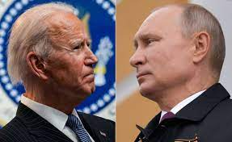

Summary
Based on Kent’s chart of probability, it is Probable England will be reaching Quarter Finals, as the calculated posterior probability is 73% and they have Chances about even to reach Semi Finals.
[1]
Based on our research and analyses, the Bayesian prior of 1% will most likely drop by certain points. Using Kent's Chart of Probability into consideration, we can label this event as an impossible event.
[2]
There's a 41.15% probability of DJIA actually finishing 2024 higher than 43,000.
[3]
Super Forecasting Project | Fall 2023

Slide 14
[1] https://www.google.com/url?sa=i&url=https%3A%2F%2Fen.wikipedia.org%2Fwiki%2FEngland_national_football_team&psig=AOvVaw1F2jcagP_lO46ISdkLTrro&ust=1701791919510000&source=images&cd=vfe&opi=89978449&ved=0CBIQjRxqFwoTCLDmk4mT9oIDFQAAAAAdAAAAABAE
[2] https://www.google.com/imgres?imgurl=https%3A%2F%2Fcloudfront-us-east-1.images.arcpublishing.com%2Fpmn%2FF5CJ5L3UCNCS7GNXDJBLZYZAH4.jpg&tbnid=SAZjE5wGJTCTIM&vet=12ahUKEwiNnunRk_aCAxVCF1kFHcLOAZQQMygKegQIARBK..i&imgrefurl=https%3A%2F%2Fwww.inquirer.com%2Fopinion%2Fbiden-putin-summit-trump-helsinki-ukraine-belarus-navalny-20210610.html&docid=gcEupDZcV0vPcM&w=2400&h=1472&q=putin%20and%20biden&ved=2ahUKEwiNnunRk_aCAxVCF1kFHcLOAZQQMygKegQIARBK
[3] https://www.google.com/url?sa=i&url=https%3A%2F%2Fen.wikipedia.org%2Fwiki%2FDow_Jones_%2526_Company&psig=AOvVaw0j_HGZBFssyQYRp4ss7Yub&ust=1701792258621000&source=images&cd=vfe&opi=89978449&ved=0CBIQjRxqFwoTCKim1qqU9oIDFQAAAAAdAAAAABAE
[4] https://en.wikipedia.org/wiki/England_national_football_team
[5] https://www.kaggle.com/datasets/cashncarry/fifaworldranking/
[6] https://en.wikipedia.org/wiki/UEFA_European_Championship
[7] https://www.transfermarkt.us/harry-kane/verletzungen/spieler/132098
[8] https://www.sportingnews.com/us/soccer/news/england-penalty-shootout-record-world-cup-history/aqnm0cdyj1orqjbxg9s9lcgz
References
Super Forecasting Project | Fall 2023

Slide 15
Thank you
Super Forecasting Project | Fall 2023

